Slide 1
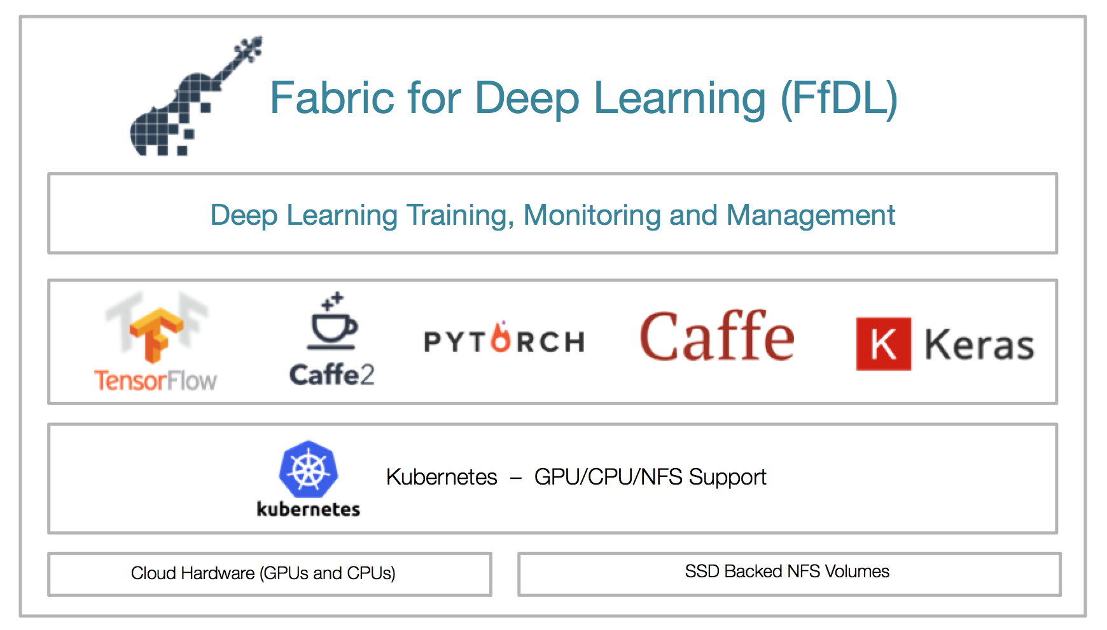
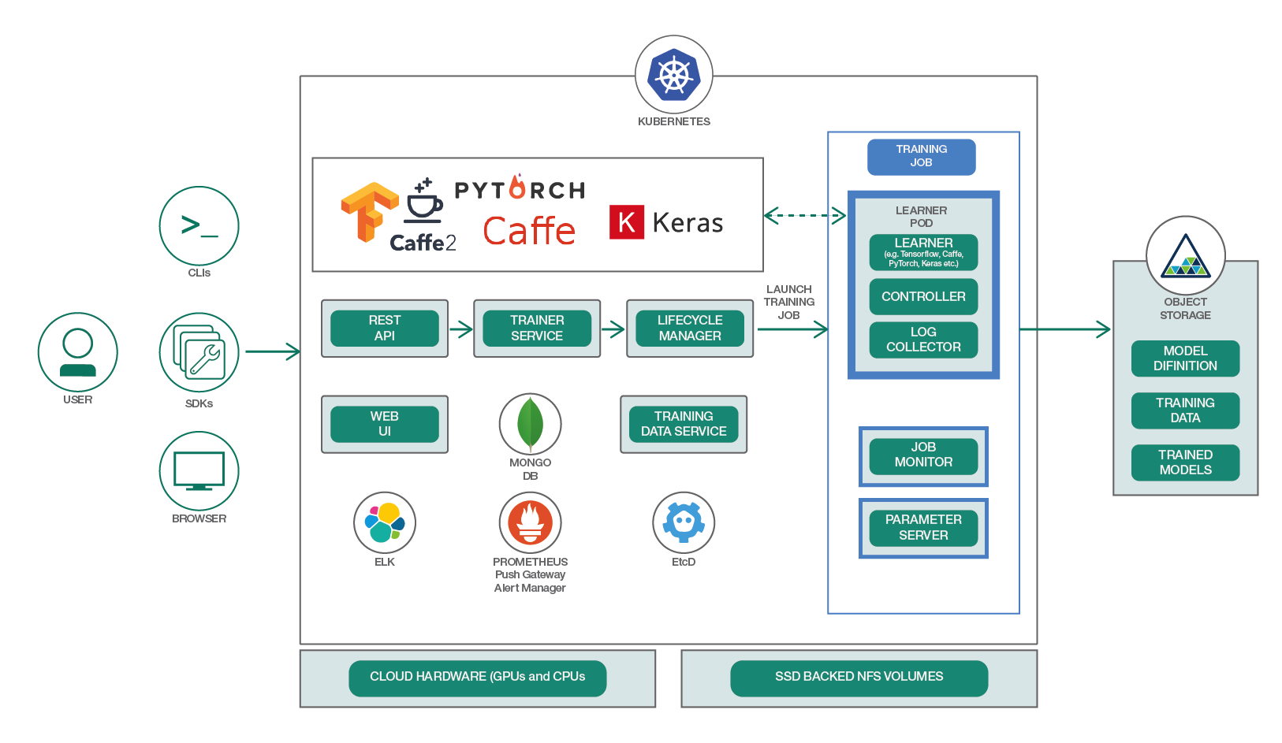
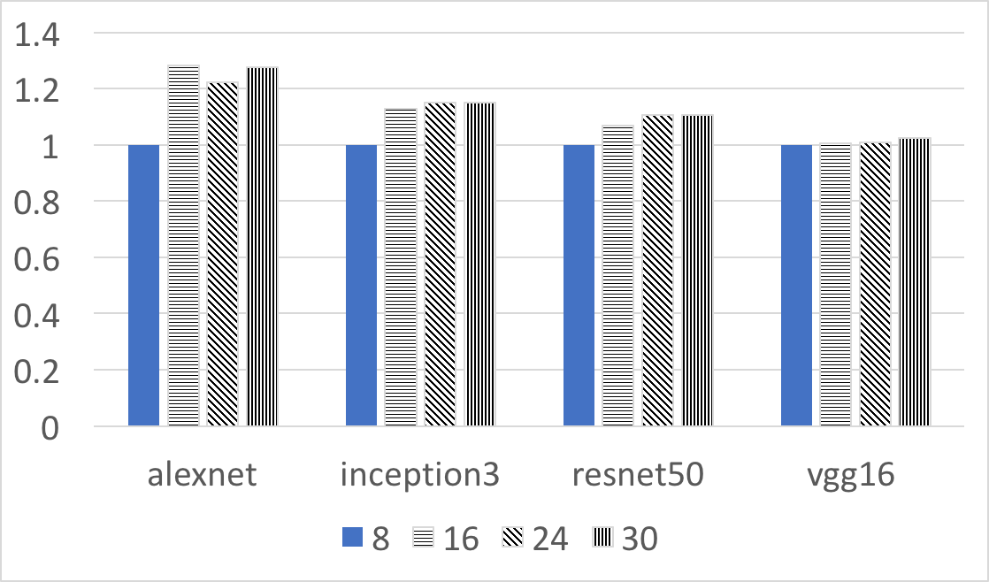
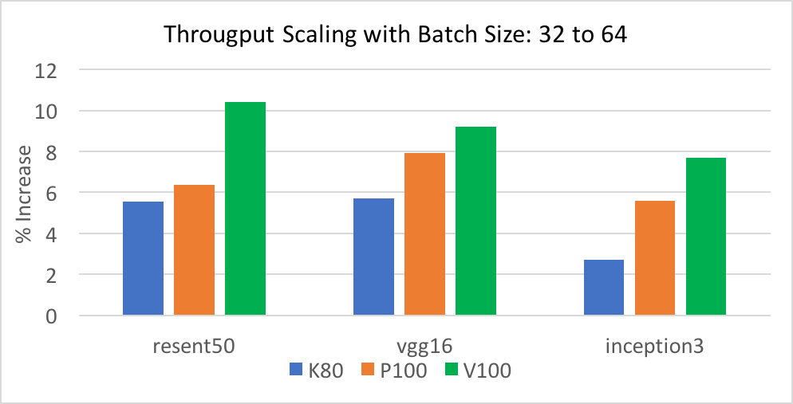
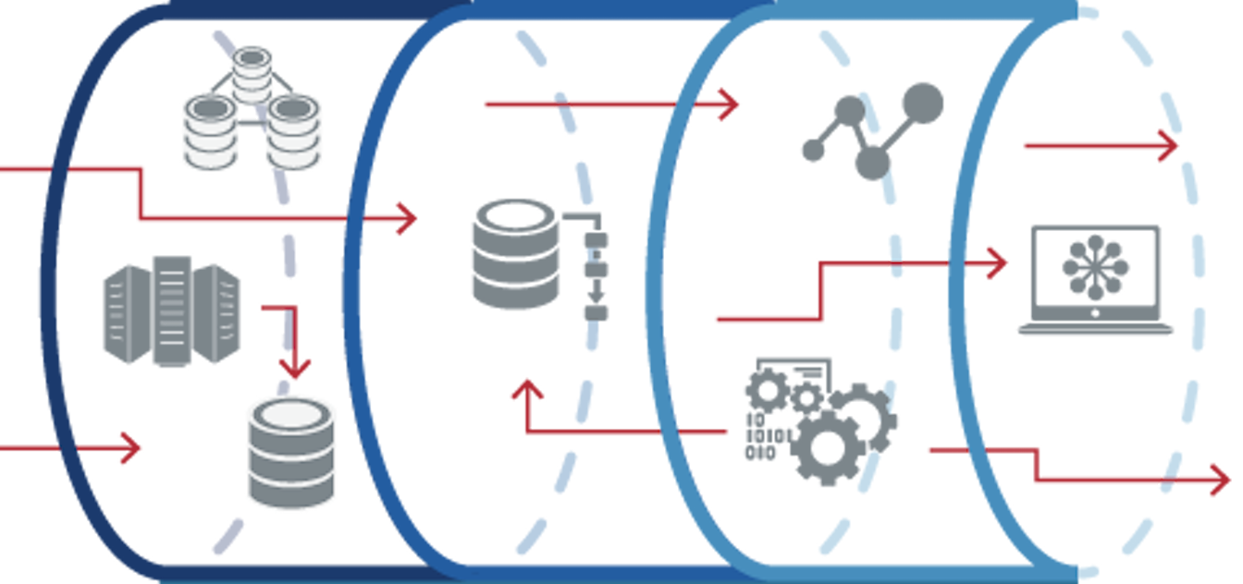
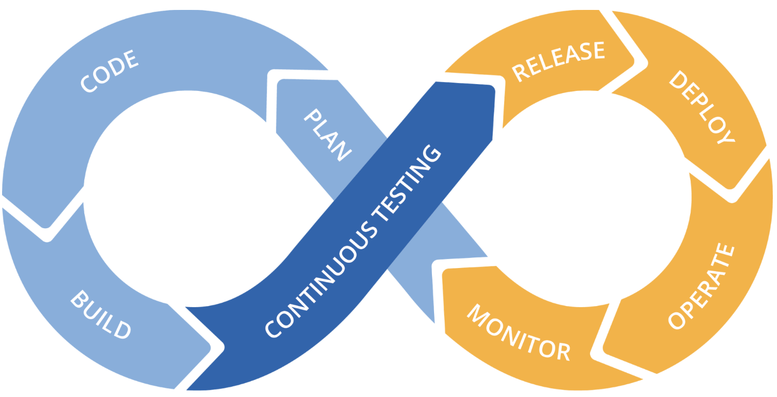
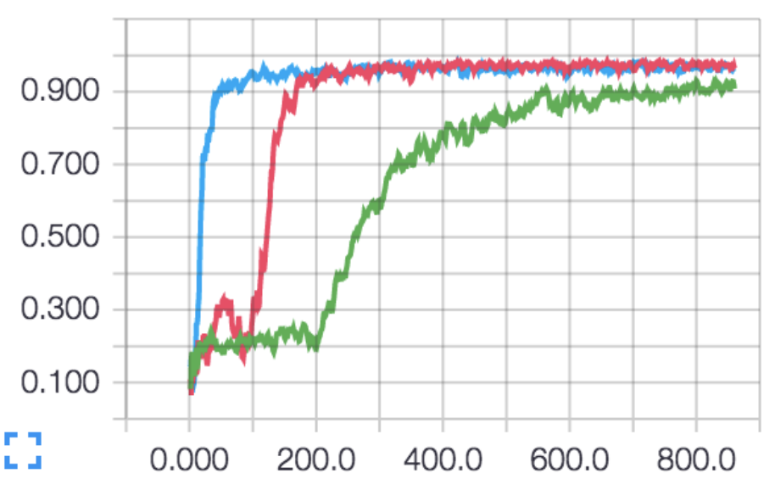
IBM Research AI
Impact of System Resources on Performance of Deep Neural Network
Parijat Dube and Zehra Sura
Training deep neural networks (DNNs) requires intensive resources for computation and memory/storage. It is important to enable rapid development, experimentation, and testing of DNNs by improving the performance of these codes. This requires understanding what system resources are exercised by deep learning codes, to what degree the utilization of different resources is impacted by changes in the compute intensity or size of data being processed by the neural network, and the nature of the dependencies between different resource bottlenecks. We are performing an extensive empirical evaluation by varying execution parameters and running experiments with different configurations of DNN training jobs. The goal is to understand how to tailor system resources and training hyperparameters to the needs of a deep learning job, accounting for both the DNN model and dataset.
Resilience
Elastic Scalability
Observability
Distributed Training
Multi-Framework
Security
IBM Fabric for Deep Learning
FfDL Architecture
https://developer.ibm.com/code/2018/03/20/fabric-for-deep-learning/
https://www.ibm.com/cloud/deep-learning
https://developer.ibm.com/code/2018/03/20/democratize-ai-with-fabric-for-deep-learning/
Factors affecting DNN Performance
Evaluation – Throughput Scaling
Parameter | Dimension | Example Choices
DNN Model | Model size Number of layers Neurons per layer Interconnection topology Compute intensity of functions | AlexNet Inception3 ResNet50 VGG16
Framework | NN libraries Inter-gpu communication Native distribution support | Tensorflow Pytorch Caffe/Caffe2
Dataset | Modality Size Encoding Training and testing datasets | Imagenet Cifar Places TREC
Batch Size | Number of data samples used in one iteration of the training job | 32, 64, 218, 256, 512
Job Resources | Number of CPU threads Type of accelerators Number of accelerators | 2, 4, 8, 16, 32, 64 NVIDIA K80, P100, V100 1, 2, 4, 8, 16, 32
Scaling with number of CPU threads on P100 cards:
8 to 30 CPU threads: 1.28x (alexnet), 1.03x (vgg16)
Scaling with batch size
Depends on GPU speed, memory, and DNN model size
Future Directions
Expand configuration parameters for a thorough empirical evaluation
Customize system resources and training hyperparameters for a DNN training job
Account for the elastic environment of a shared cloud system:
Delays due to sharing
Delays due to resource failures
Opportunities due to additional resource availability
Continuous feedback and control mechanism to interact with users and service modules
Data Preprocessing
Pipelines
Scalable
Model Training
Continuous Testing
and Improvement
Evaluation and
Debugging

